Slide 1

SDG 2: Zero Hunger
Matthew O’Rourke Bourke
K00287407

Slide 2
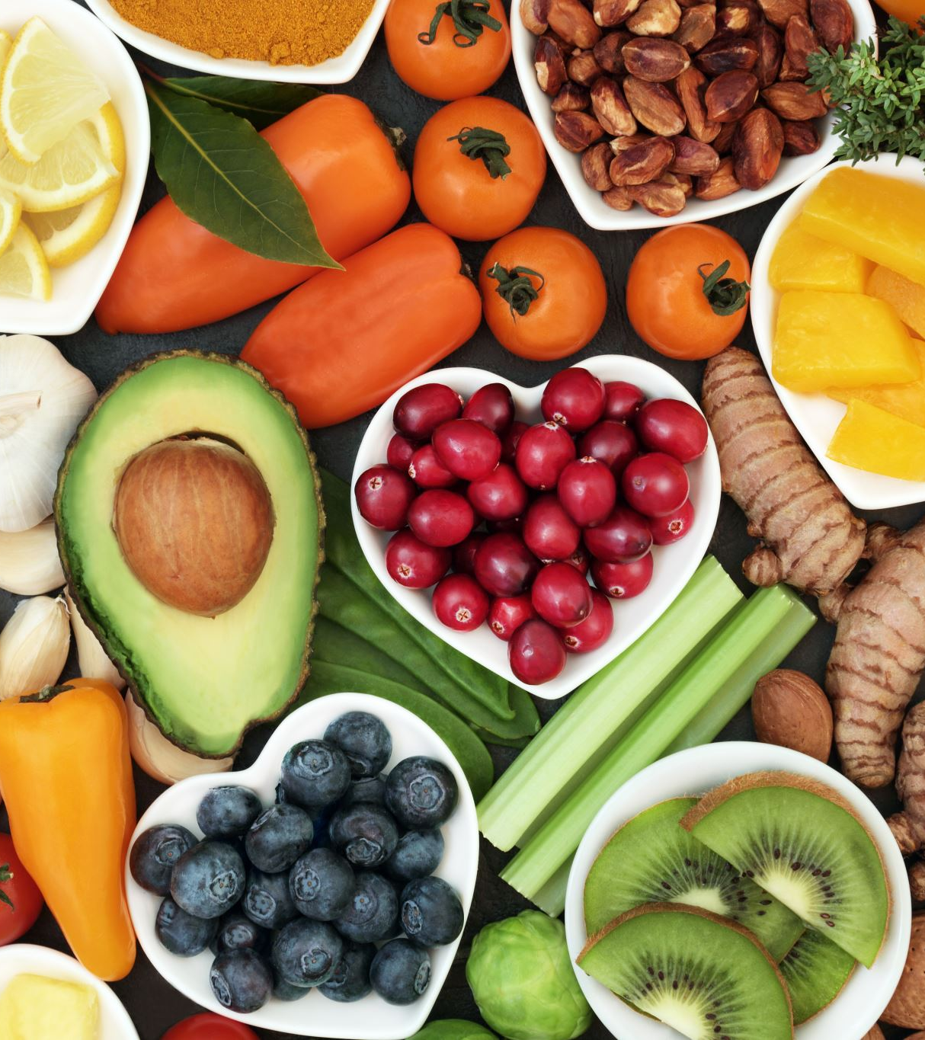
What is Zero Hunger
Number 2 of the sustainable development goals brought by the United Nations
Goal: To end hunger, achieve food security and improve nutrition by 2030
Objectives: To increase access to food, reduce food waste and introduce healthy eating habits

Slide 3

Global Hunger Statistics
More than 600 million people affected globally
1 in 3 people experience moderate to severe food insecurity
Millions of children globally suffer from malnutrition

Slide 4
Causes of World Hunger
Structural Causes: Poverty and Economic inequality
Environmental Causes: Climate change including droughts and floods
Political causes: Conflict and war, displacement of people
Systemic causes: Food waste and unequal distribution

Slide 5

Sustainability
Sustainable farming – environmentally friendly
Reduce food waste
Support local food businesses
Equal Access to food
Food security = Sustainable and accessible food

Slide 6
What we can do to make a change
Reduce food waste in the home
01
Make healthy food choices – increase nutrition
02
Educate ourselves on nutrition and sustainability
03

Slide 7
Role of computer science
Digital tools can:
- Simulate real problems
Increase student engagement
Visualise and tailor learning to different groups of students
Examples - apps, games and webpages

Slide 8
Role of education
Schools can: increase awareness, teach healthy eating habits, engage students with this and other SDGs
Primary education is important

Slide 9
Problem Identification
Lack of awareness of global hunger and nutrition issues
Traditional primary and secondary level teaching may not focus on this issue and lacks engaging learning for these age groups

Slide 10

Justification of my application
Encourages learning about Zero Hunger through a fun and engaging environment
Allows for a wide age group of students to engage and learn
App teaches – decision making, gives examples of healthy food, teaches coding and explains the SDG Zero Hunger

Slide 11
References
https://www.un.org/sustainabledevelopment/hunger/
https://www.fao.org/sustainable-development-goals-data-portal/data/indicators/2.1.1-prevalence-of-undernourishment/sdg-2-indicators-of-hunger-and-severity-of-food-insecurity/en
https://www.who.int/news/item/28-07-2025-global-hunger-declines-but-rises-in-africa-and-western-asia-un-report
https://www.tandfonline.com/doi/full/10.1080/21683565.2025.2451344

